Slide 1

Department of Computer Science and Engineering Marathwada Institute of Technology, Aurangabad Maharashtra State, India 2018-2019
NEUROLOGIST APPOINTMENT SCHEDULER DESIGN
Submitted by
MANDAR KULKARNI
SWAYAMBHU KURDUKAR
PRATIK NAGE
YOGESH KANHEGAWANKAR
Guided by
Prof. Sushma D. Ghode

Slide 2
CONTENTS:
Introduction
Requirement Analysis
System Design
Implementation
Testing
Deployment Observation
Conclusion
References

Slide 3
INTRODUCTION
A Neurologist is a doctor who specialized in treating diseases for the nervous system.
The software’s main focus is to ease the appointment procedure.
It does so by making appointment procedure online.
Respective doctor can see their respective appointments list of patients.

Slide 4
Requirement Analysis
Hardware Requirement
Laptop,mobile.
Software Requirement
LAMP,XAMPP,WAMP,SMS gateway.
Functional
Modules-Dashboard,login,Appointment Booking.
Non-Functional
Planning
Cost estimation.

Slide 5
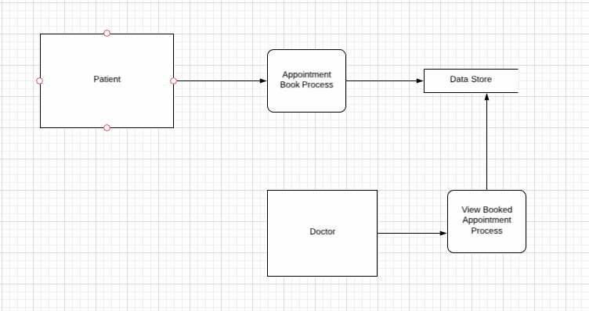
System Design
DFD Diagram:

Slide 6
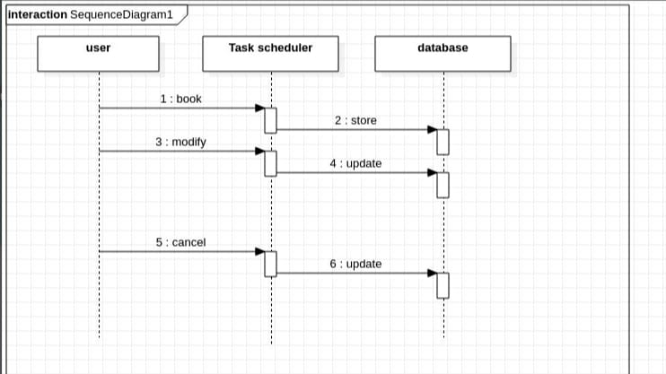
Sequence Diagram:
SEQUENCE DIAGRAM

Slide 7
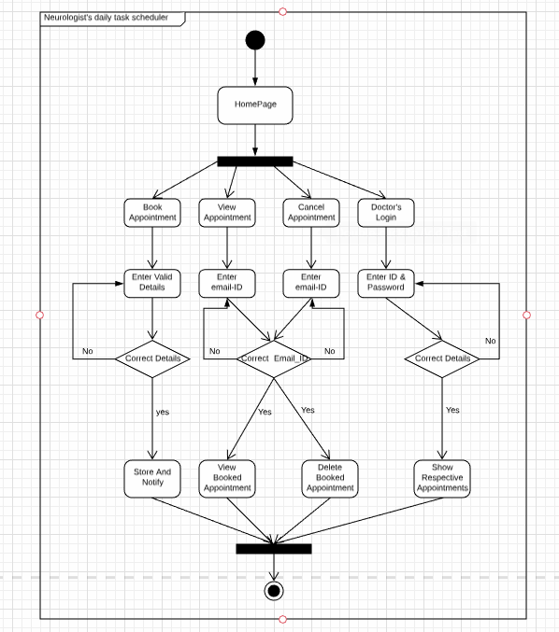
Activity Diagram:

Slide 8
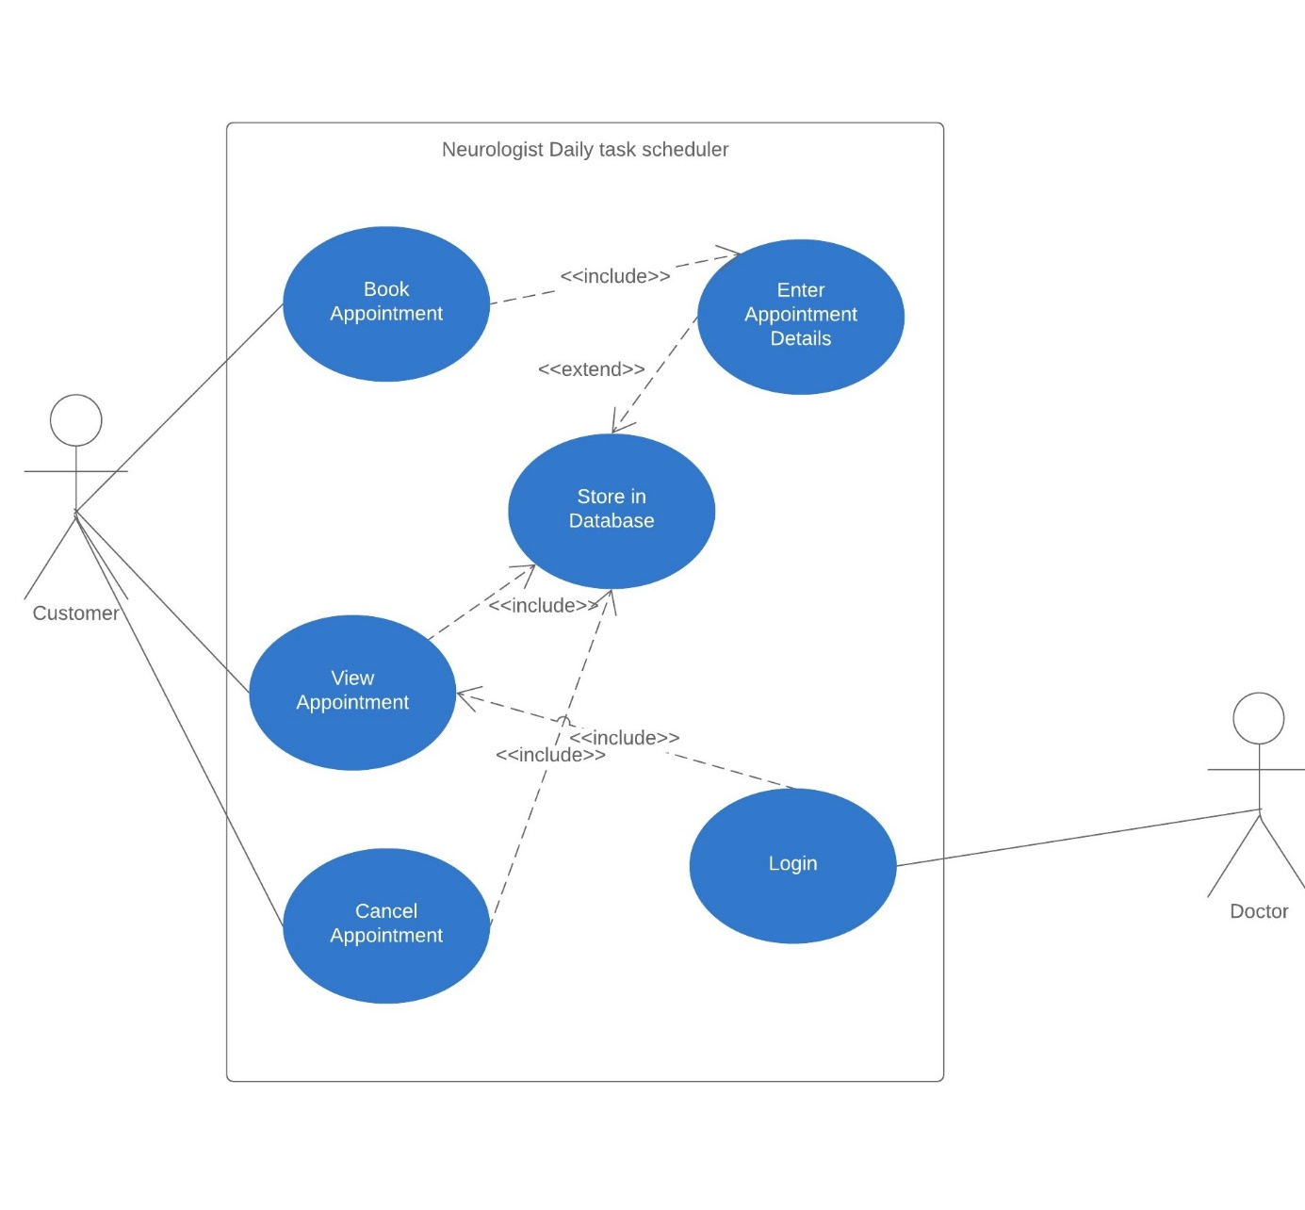
Use case Diagram

Slide 9
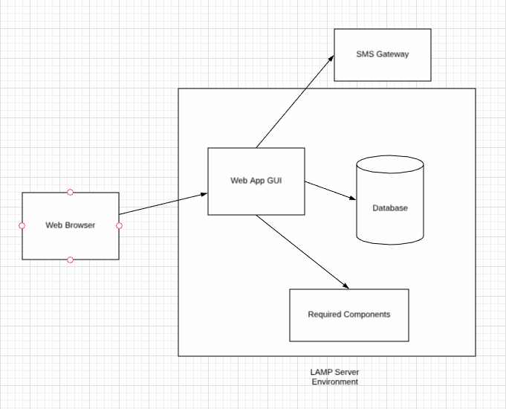
Architectural Diagram:

Slide 10
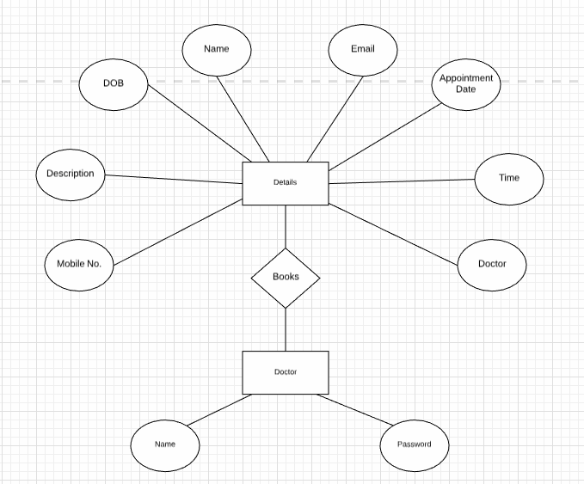
ER diagram:

Slide 11
Implementation
Code uses HTML, CSS, Js for front end Design.
PHP for connectivity and Back end Design.
Mysql for Database.
SMS Horizon as SMS gateway.

Slide 12
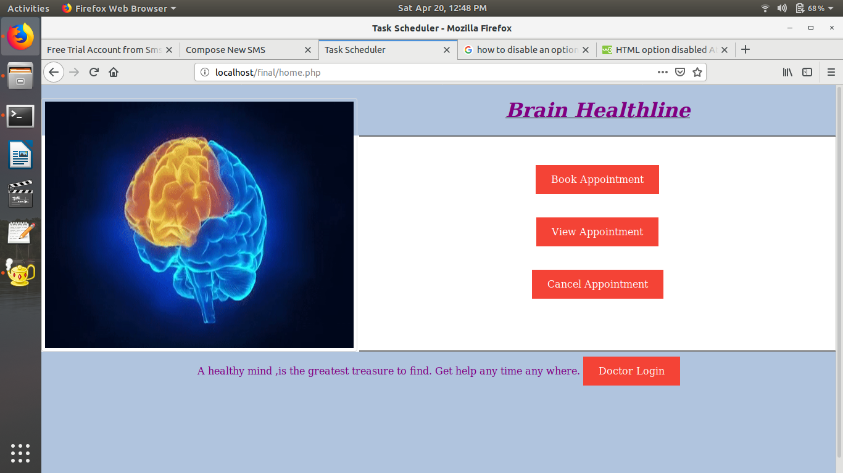
HOMEPAGE

Slide 13
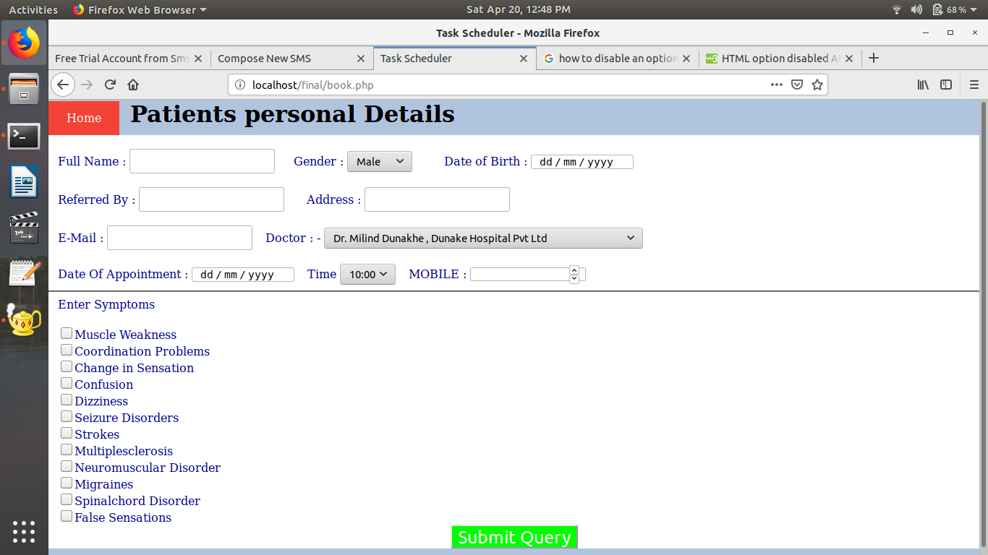
APPOINTMENT PAGE

Slide 14
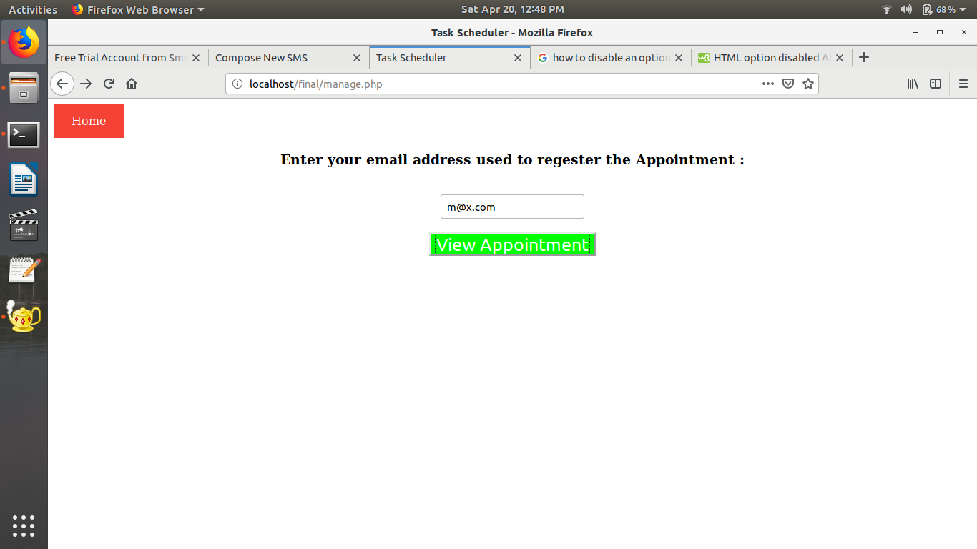
VIEW APPOINTMENT PAGE

Slide 15
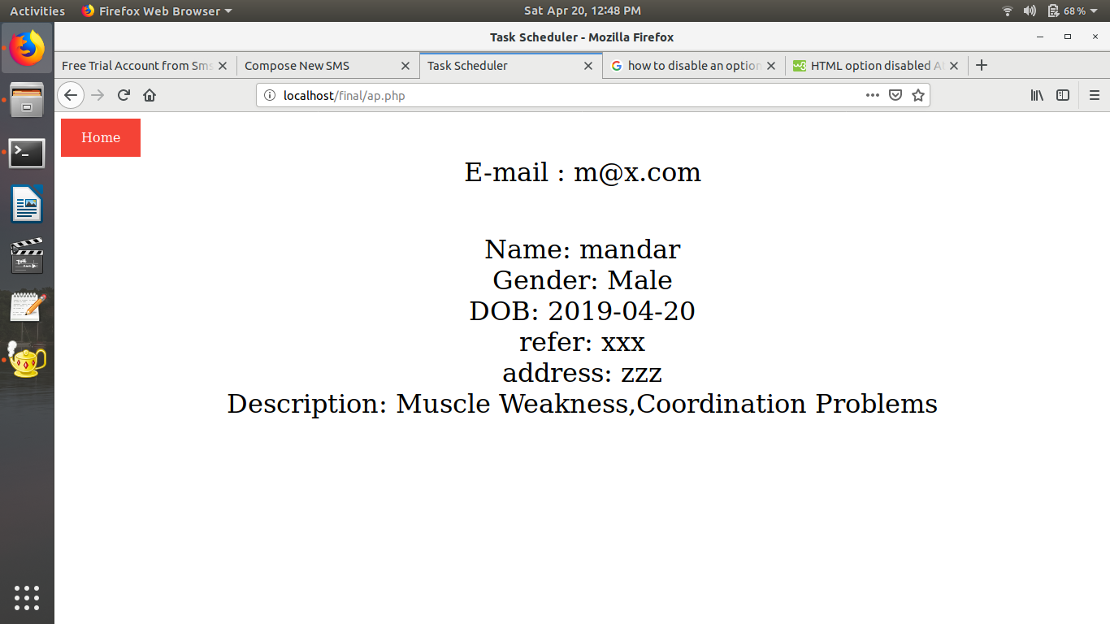
VIEW DETAILS

Slide 16
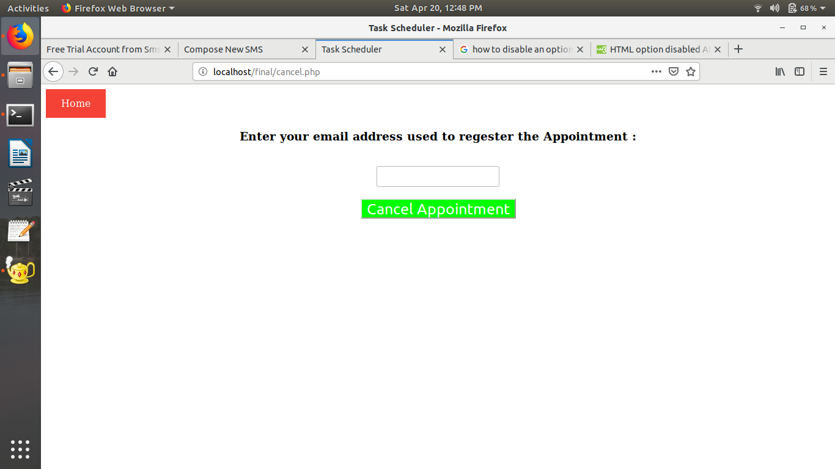
APPOINTMENT CANCEL PAGE

Slide 17
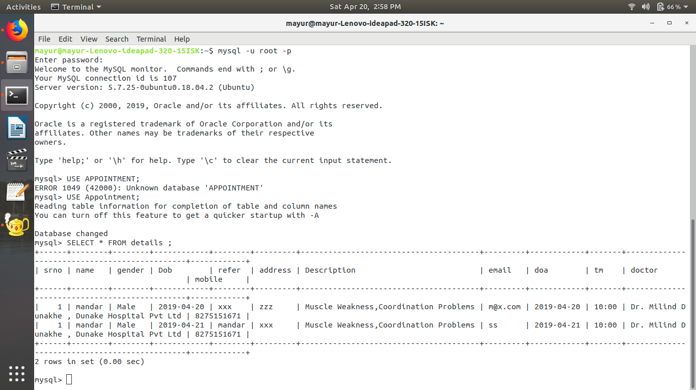
DATABASE

Slide 18
Testing
Unit testing is performed for Validation
Use case testing is performed as per the scenarios.
Testing is performed on
Home Page and its functionality.
Login Page & Booking page for its validations.

Slide 19
Deployment Observation
Observations
Login successfully only when credentials are correct.
Messages are delivered only when phone no. is valid.
Only valid information will be stored as per validations.

Slide 20
Conclusion
By all requirement gathering and the investigation of the applicability, conclusion of this appointment scheduler enables you to
automatically perform routine appointments of doctors on chosen computer.
Booking on phone is quite easy & reliable.

Slide 21
References
[1] www.microsoft.com
[2] www.appointmentmanagementsoft.com
[3] www.windowsreport.com.
[4] www.wikipedia.com
[5] https://zapier.com/blog/best-appointment-scheduling-apps/
[6] https://en.wikipedia.org/wiki/Appointment_scheduling_software
[7]https://www.smshorizon.in/?gclid=Cj0KCQjwov3nBRDFARIsANgsdoE33Pg3QTu9URz0JGK7DIc7eO4hJyEJF31Ehq4sTv8D6avg-zcvNXwaAknEEALw_wcB

Slide 22
Thank You

